Slide 1
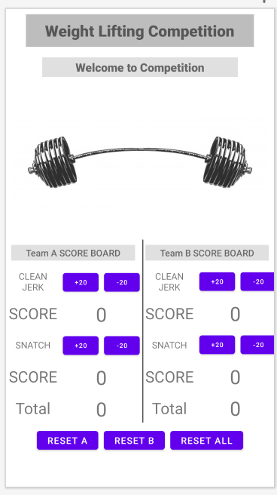
Text
Linear
Relative
Text
Image
Scroll
Text
Image
Text
Text
Button
T
B
B
T
B
B
T
T
T
T
T
B
B
T
B
B
T
T
T
T
T
T
T
T
B
B
B

